Slide 1

Ballroom Dance Studio Management System

Slide 2
class Project3 extends Project2 { constructor(“View & Schedule Events”, “Track & Manage Attendance”, “Kicks chat system” ) { super(“it’s all there”); this.add = [“Invoice & Payment System”, “Live Chat”] this.refactor = “Use MongoDB & React, theme to Ballroom Dance Studio” this.versatile = “Practical, user-friendly software that can be used for countless purposes. } };

Slide 3
Const screen = screen.map(x => x.img);
Const interface = () => {
if (user || student) {
return [“schedule”, “view events”, “sign up”, “chat”, “view and pay invoices”, “see reminders” ]
};
if (admin || staff) {
return [“track attendance”, “edit schedules”, “add/edit/remove users”, “view sales reports”, “view and create invoices”, “payment log” ]
};

Slide 4

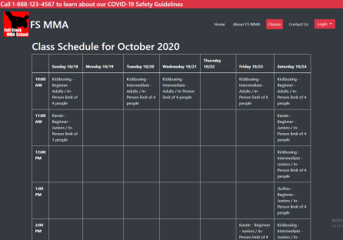
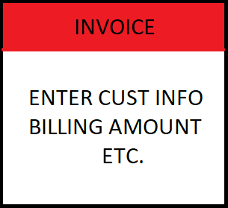
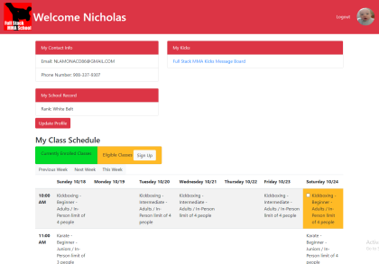
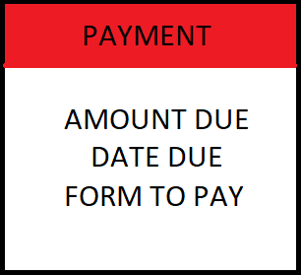
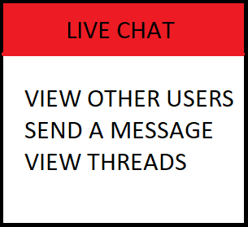
[{ wire: “frame” }]

Slide 5
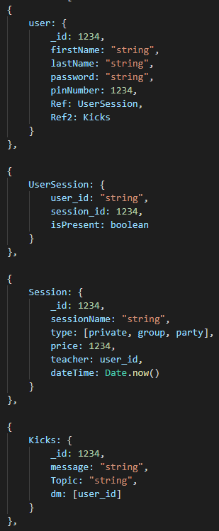
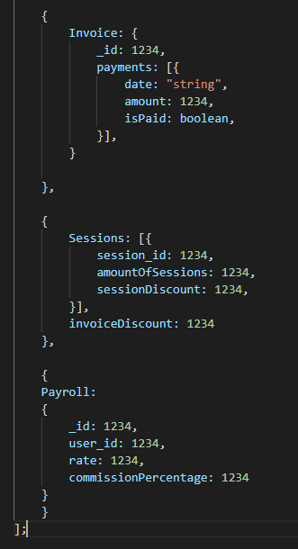
const Models = [{}]

Slide 6
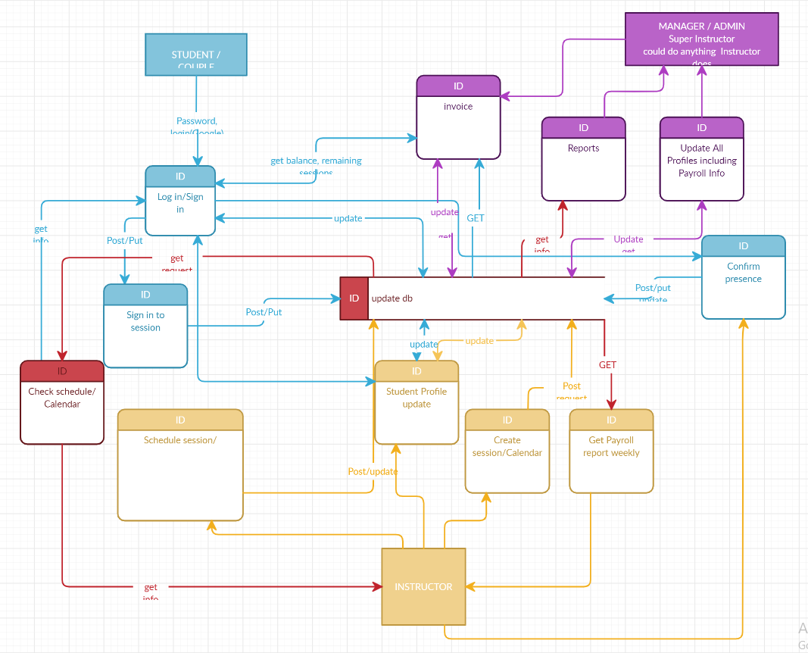
console.log(dataFlow);

Slide 7
Const memberRoles = [
{sergey: “Database Structure”},
{jonathan: “React Development”},
{nick: “API, routing & Presentation”},
{michael: “Delegation and React Development”},
{all: “Explore and Learn New Technologies”}
];

Slide 8
function resolveByNovemberEleventh() {
let toDo = [“Convert to MongoDB”, ”Learn and create chat system, payment processing, and invoices”, ”develop React interface”, ”test, debug and deploy”, ”polish and present project to the class”]
return new Promise(resolve => { setTimeout(() => { resolve('resolved'); }, 8.64e+7 * 19); });
};
async function asyncProject() {
const project3 = await resolveByNovemberEleventh();
return project3
};
asyncProject();

